Slide 1

Bank Customer Segmentation
A look into existing customers and attrition

Slide 2
Bank Customers Dataset
In an effort to assist bank owners in understanding customers, specific to their existing customers vs those who attrite, I found a dataset titled Credit Card Customers Prediction, from Kaggle.com (https://www.kaggle.com/datasets/whenamancodes/credit-card-customers-prediction), which provides valuable information regarding attrition.
In the aforementioned dataset you will find that there is customer information, such as marital status, education level, income, credit limit, number of transactions and much more.
The question I seek to answer to is, how do attrite/existing customers get segmented and what insights can be drawn using unsupervised learning algorithm? I hope to inspire Bank owners to further scrutinize this matter
I will utilize Python and many supplemental libraries to tackle this problem
A Google Collaboratory Notebook was used to run Python (https://colab.research.google.com/drive/126_thjg9qX2o-VCph0hXMhAgL9MDRQdy?usp=sharing)

Slide 3
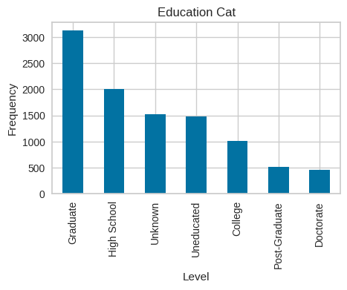
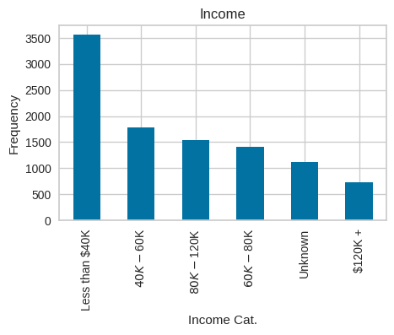
Starting the process
The Credit Card Customers Prediction dataset started with 23 fields and 10,127 records
I did some data exploration analysis, such as familiarizing/understanding all fields—visualizing the data like in the two figures off to the right—, viewing all field type, identifying blank records, identifying fields with outliers and uneven distribution, and identifying correlations between features

Slide 4
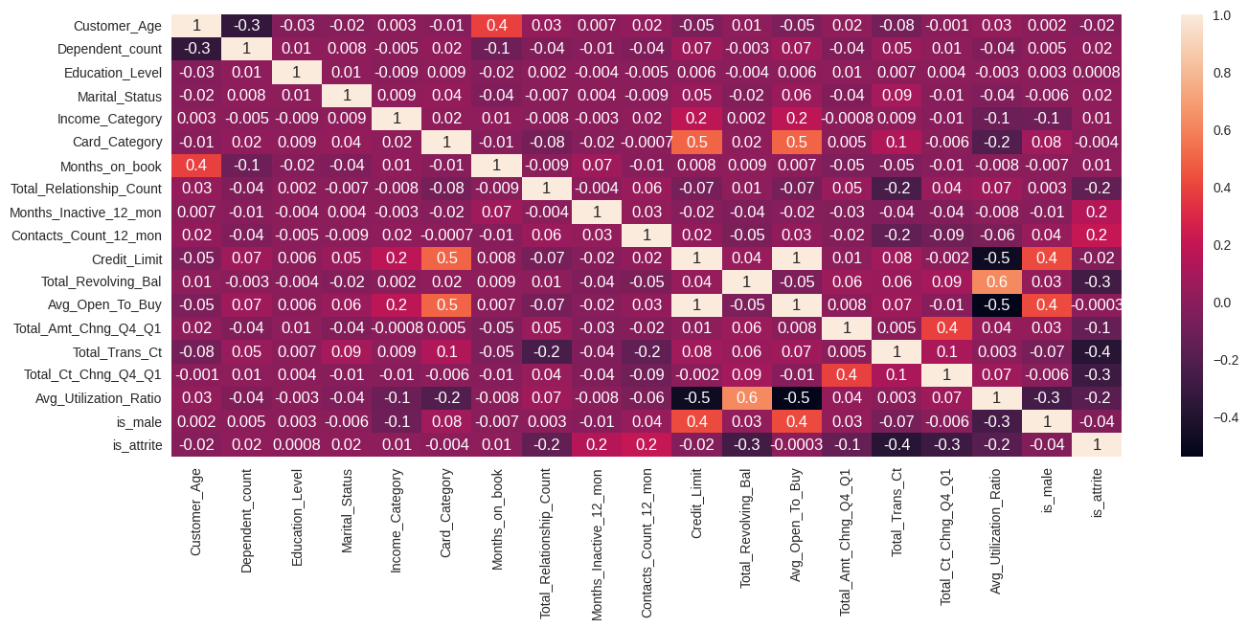
Some features/fields do more harm than good
Upon initial exploration of the dataset, I found that:
6 of the 23 fields were string types which were converted to numeric
e.g. Card_Category ['Blue' 'Gold' 'Silver' 'Platinum’] was converted to categories [1, 2, 3, 4], respectively
2 of the 23 fields were dropped (removed) as they did not hold value in this study
2 fields were dropped due to having high correlations with other fields
e.g. Credit Limit scored 1 in correlation to Avg_Open_To_Buy, which was a field that demonstrated willingness to use their credit limit
2 fields were dropped due to having many outliers and being skewed
Ultimately, I ended up with 15 total features and 1 target, for a total of 16 columns and 10,127 records
16% attrite vs 84% existing customers

Slide 5
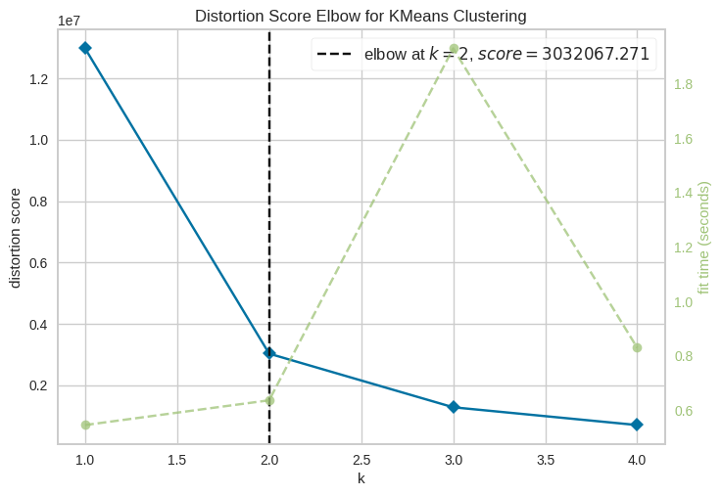
Elbow Plot for K Means Clustering
The YellowBrick library in Python has method called KElbowVisualizer which allows for end users to gain insight into how the ideal number of clusters exist in their dataset
The most optimal number of cluster will show a breaking point, such as the illustration to the right, which shows 2 as the optimal number
We will be using 2 clusters throughout the study

Slide 6
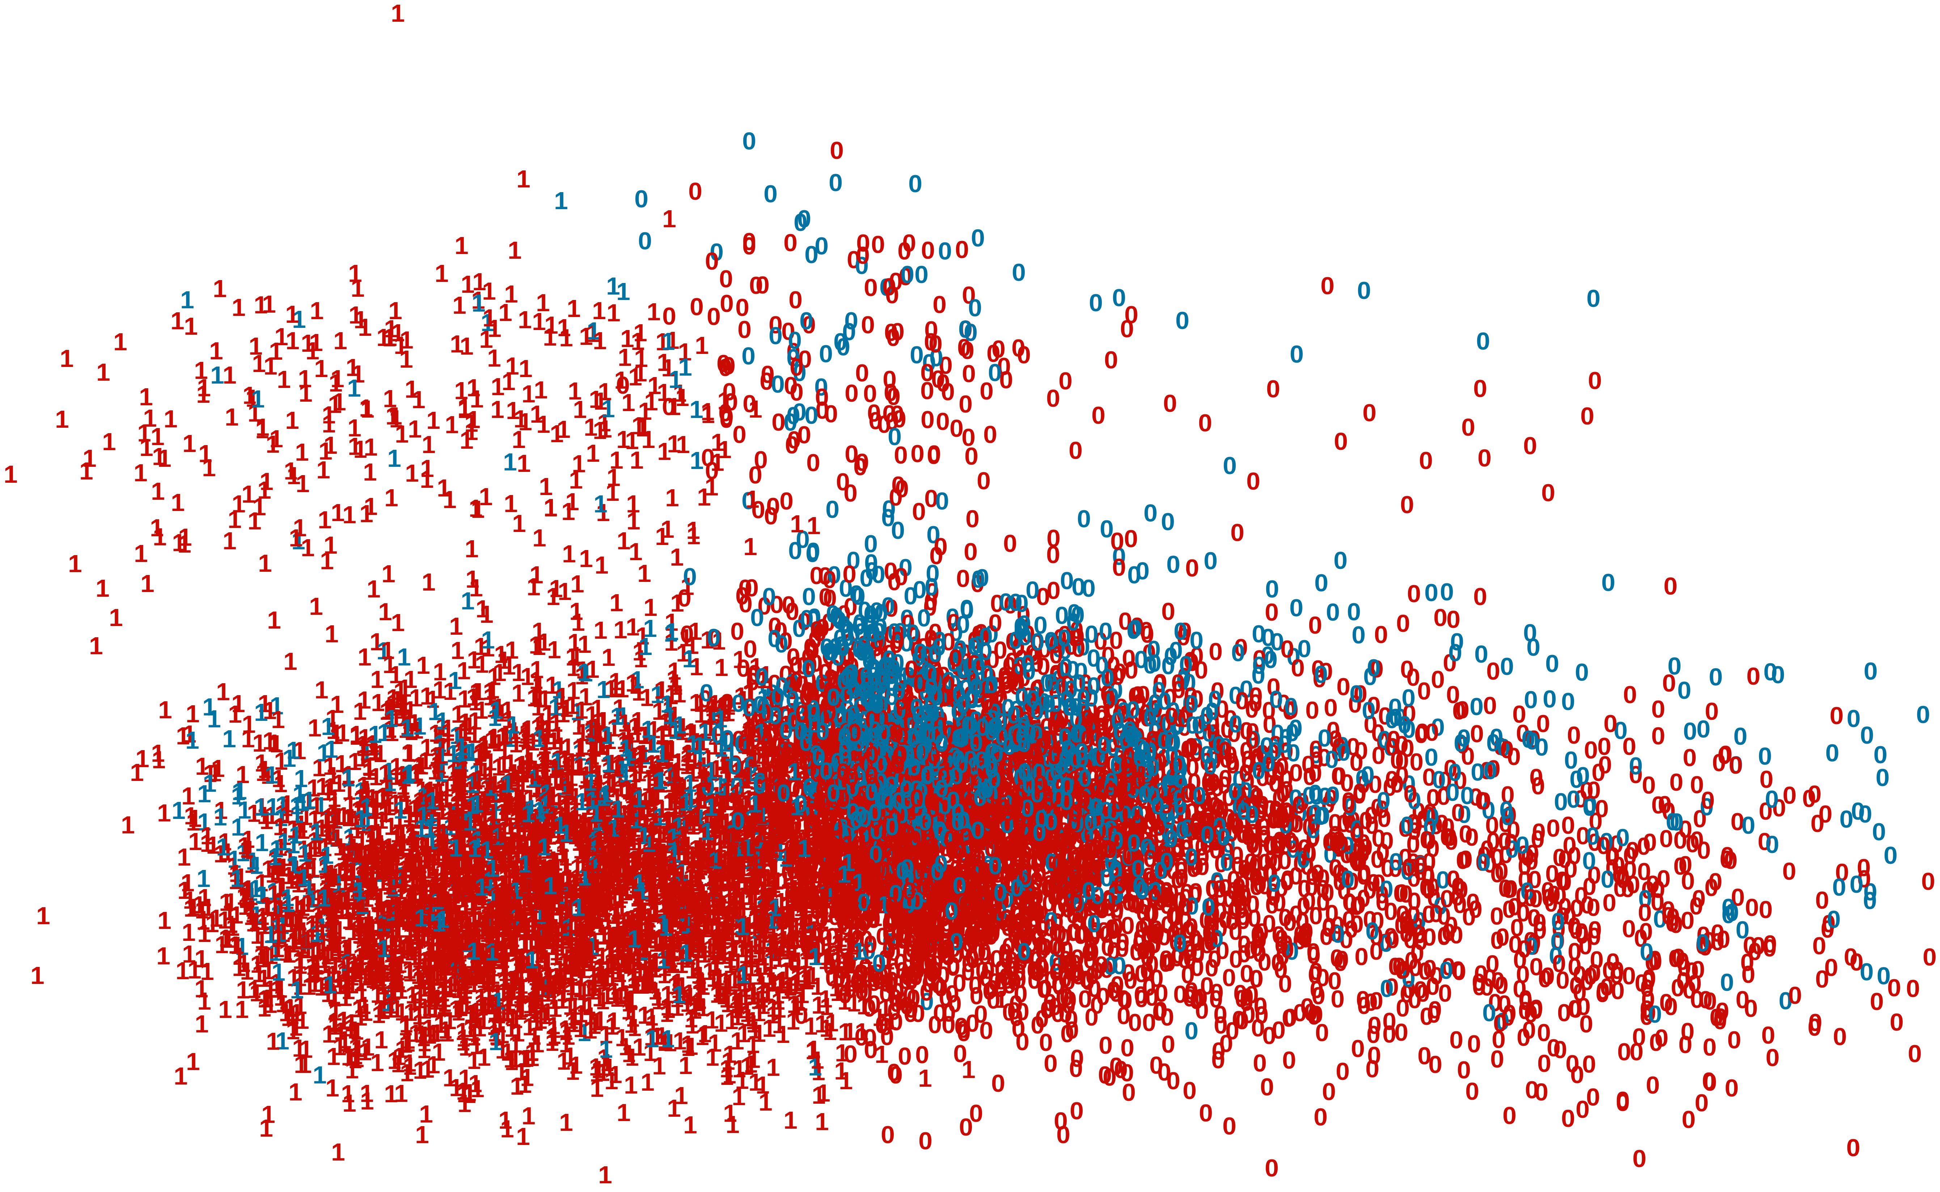
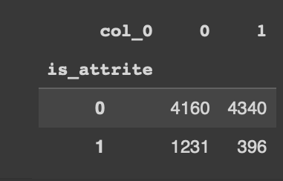
K Means
I ran K Means Cluster algorithm with a parameter of 2 clusters, where red is showing existing customers and blue is showing attrites
K Means is an algorithm that attempts to find the center (centroid) of each point, once an initial centroid has been identified alike points are placed nearby
In the visual to the top right, both groups are in fact embedded into one another where its difficult to visualize any true separation between clusters
This model yielded a 0.008 Adjusted Rand Index (ARI) score which is extremely low (we want to get close to 1)
Off to the bottom right you will find a matrix showing that 4,160 were correctly clustered into the existing customer group and 396 were clustered correctly into the attrition group. However, K Means mistakenly categorized 4,340 attrites as existing customers and 1,231 were mistakenly existing customers as attrites, which explains the low score

Slide 7
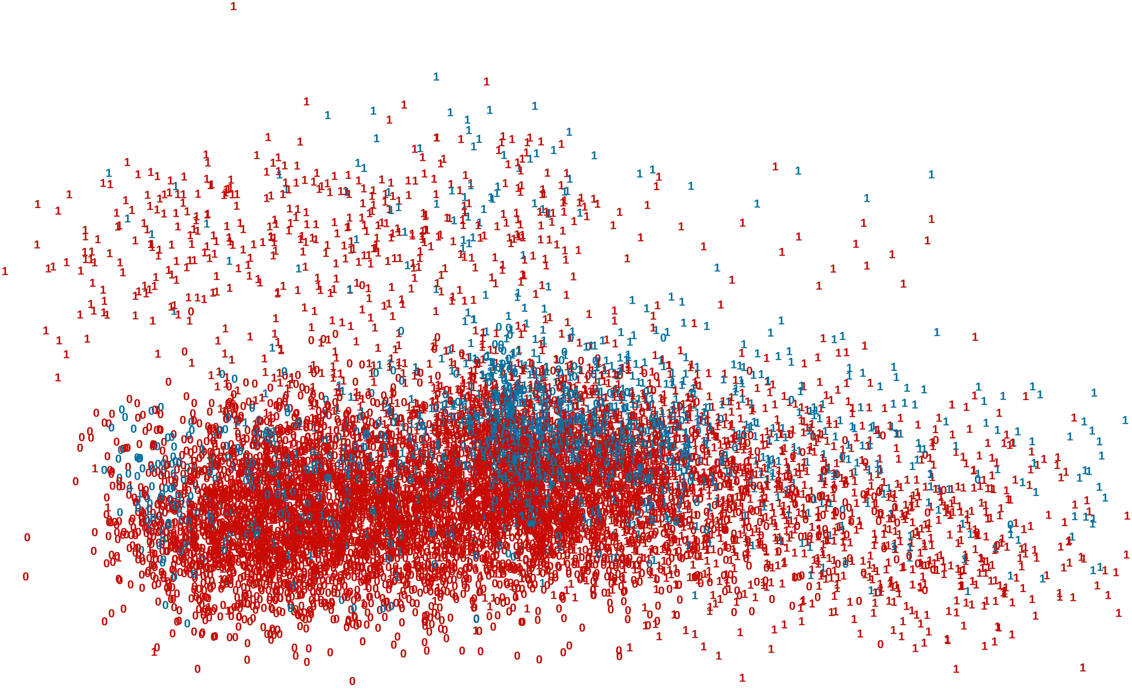
Hierarchical Clustering
Off to the right are the results for our attempt at getting a hierarchical clustering model and it looks similar to the graph produced by K Means, and does not provide additional insights
This type of algorithm attempts to combine based on the most similar features based on distance
Moreover, the ARI score was 0.011, which was slightly higher than K Means

Slide 8
Dimensionality Reduction
t-SNE Dimensionality Reduction
Dimensionality Reduction is the process of reducing the amount of features and removing redundancies
t-SNE is a reduction algorithm that preserves local similarities between points while providing low dimensionality (reduced features
UMAP similar to t-SNE reduces dimensionality but is computationally faster and focuses more on global similarities
By reducing dimensionality in UMAP, we can more clearly see that most attrites are clustered in the right region. Although, there is no discernable difference between existing customers and attrites in that specific region. Perhaps the similarity in this region will depict which existing customers will eventually attrite, based on their similarities
UMAP Dimensionality Reduction

Slide 9
Recap
We took a dataset from Kaggle, about Bank Customers and explored/cleaned data such as Income, Marital Status, Educational Level, Number of Transaction, Gender and some others
Using Python, we removed noisy (outliers) data, removed fields with little to no value. Converted string fields to numerical and removed highly correlated fields
We ran K Means and Hierarchical Cluster algorithm, where the ARI score was low and many data points were miscategorized vs the ground truth (true existing customers and true attrites)
We reduced dimensionality to create a better view for drawing conclusions and found that most attrites are indistinguishably clustered around specific existing customers

Slide 10
Recommendations
Since most attrites seem to be clustering around the right side of UMAP figure, this may be pointing to some important information about existing customers who fit the attritrition criteria. This type of insight, combined with some supervised learning techniques can help derive additional insight into predictors around
My recommendation is to take a closer look at this cluster of customers and the attrites who share similar qualities for further understanding of what this dataset is suggesting

